Slide 1
Problematiche nutrizionali nellʼadulto e nellʼanziano:
paziente con BPCO e paziente con diabete.
Dr. V. Emanuele

Slide 2
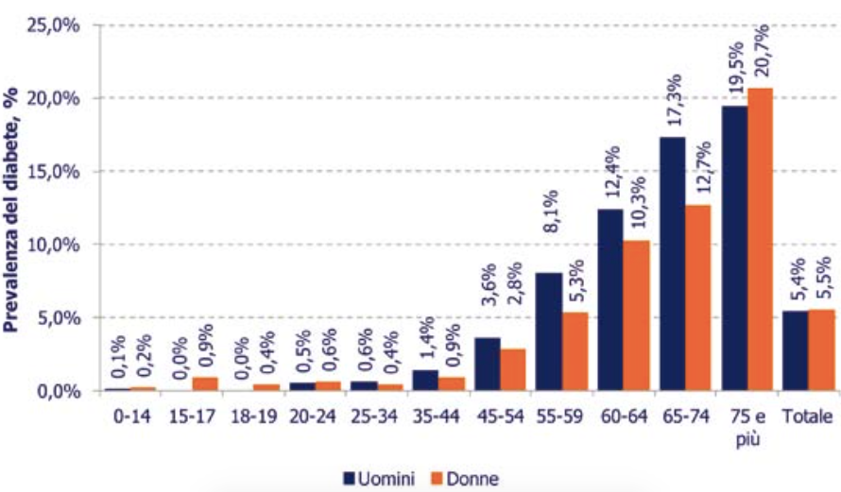
Prevalenza Diabete. Italia. ISTAT 2013.

Slide 3
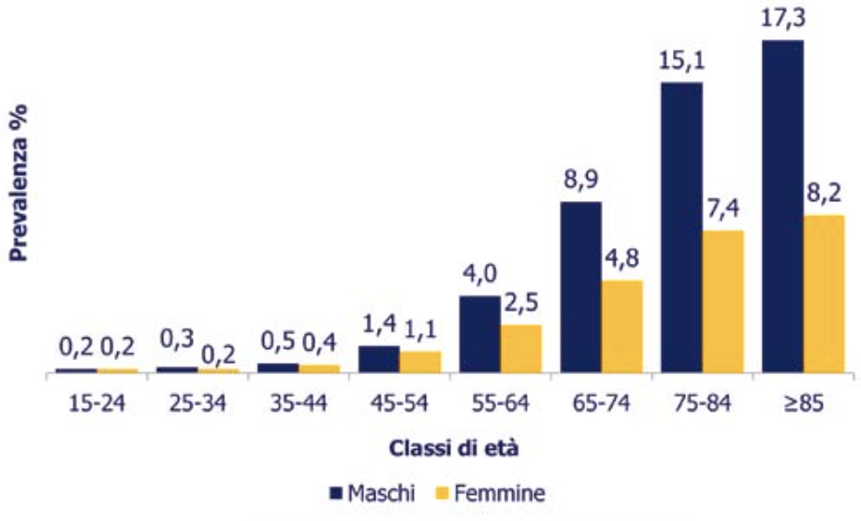
Prevalenza BPCO. Italia. S.I.M.G. 2013.

Slide 4
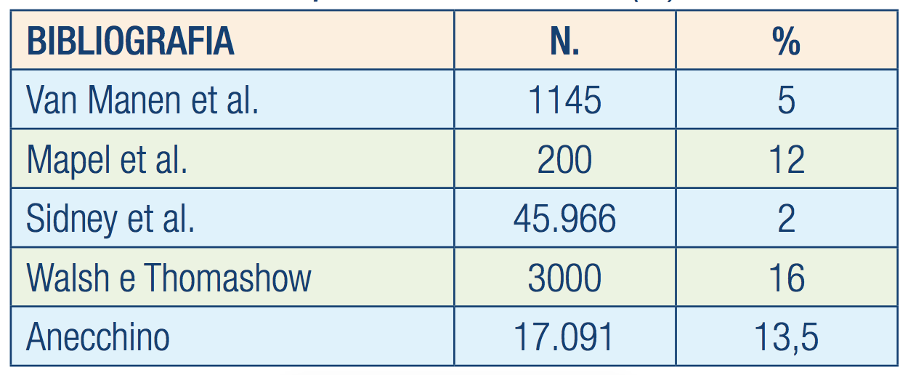
BPCO e Prevalenza DIABETE.
Media: 9,7 %
Ruggeri et al MeDia 2008;8:137-142

Slide 5
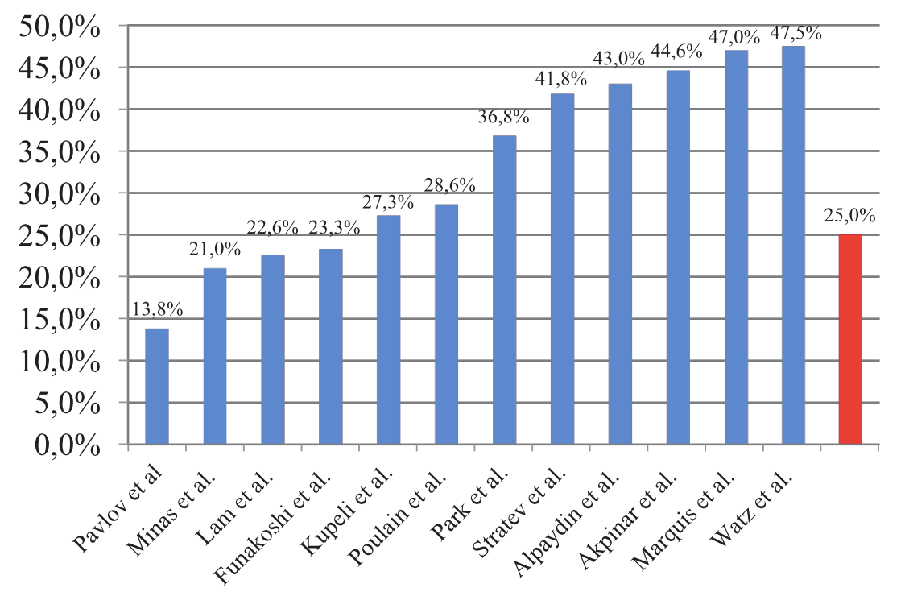
Prevalenza Sindrome Metabolica in BPCO
Mekov et al. PeerJ 3:e1068;

Slide 6
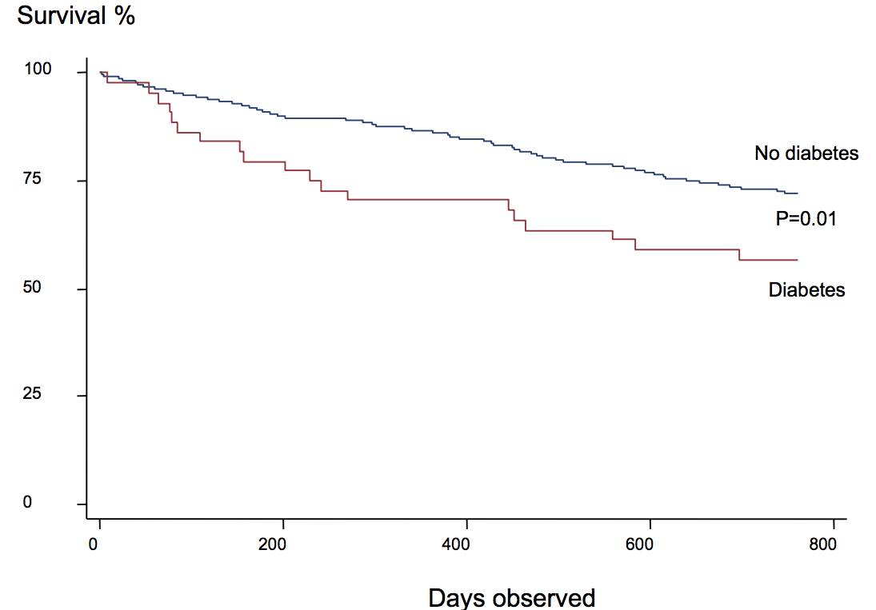
COPD. Survival in DM e NON DM.
Gunnar Gudmundsson. Respiratory Research 2006, 7:109

Slide 7
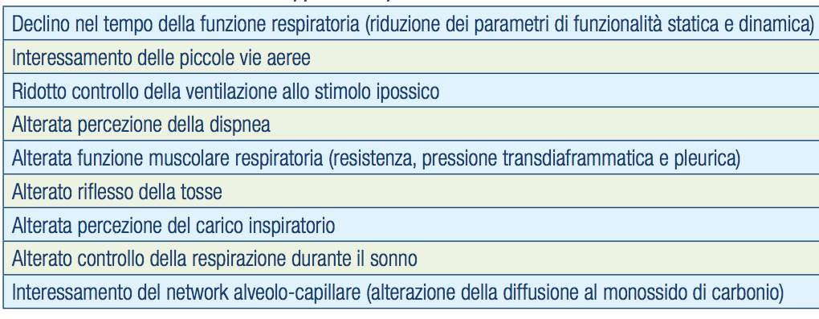
Effetti Diabete su Apparato Respiratorio
Ruggeri et al MeDia 2008;8:137-142

Slide 8
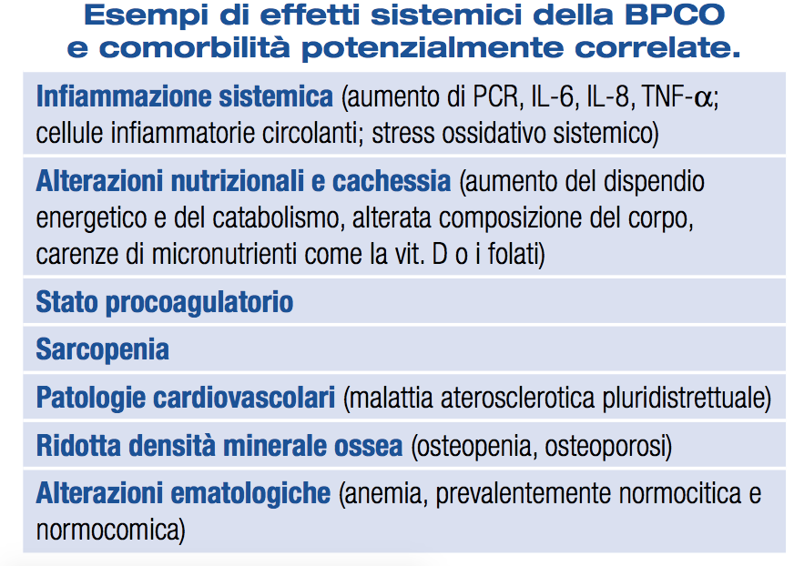
S.I.M.G. 2011 - Dr. Bettoncelli

Slide 9
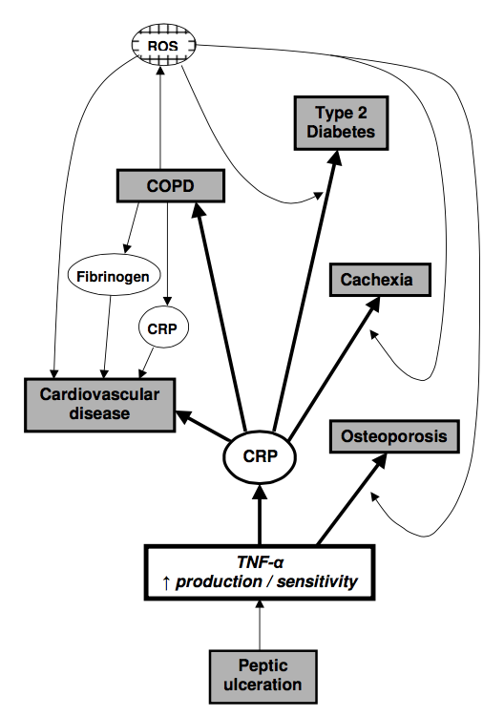
Martin J Sevenoaks. Respiratory Research 2006, 7:70

Slide 10
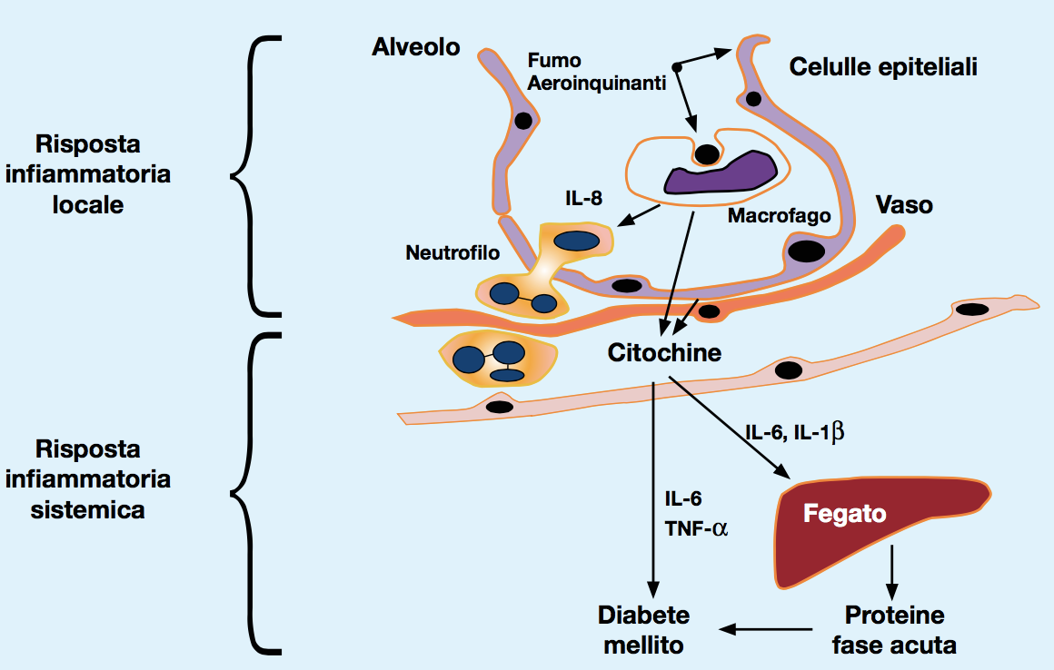
INFIAMMAZIONE, BPCO e DIABETE.
Ruggeri et al MeDia 2008;8:137-142

Slide 11
Che Strada Prendere ?
INSULINA
IPOGLICEMIZZANTI
TARGET GLICEMICO
PZ CRITICO
TIMING NUTRIZIONE
PZ NUTRIZ ENTERALE
PZ CARDIOPATICO
PZ NUTRIZ PARENTERALE
PZ CRONICO
PZ DIETA
PZ OBESO

Slide 12
UTIC/UTI

Slide 13
Che Strada Prendere ?
INSULINA
IPOGLICEMIZZANTI
TARGET GLICEMICO
PZ CRITICO
TIMING NUTRIZIONE
PZ NUTRIZ ENTERALE
PZ CARDIOPATICO
PZ NUTRIZ PARENTERALE
PZ CRONICO
PZ DIETA
PZ OBESO

Slide 14
Original Article Hypoglycemia and Risk of Death in Critically Ill Patients
The NICE-SUGAR Study Investigators
N Engl J Med
Volume 367(12):1108-1118
September 20, 2012

Slide 15
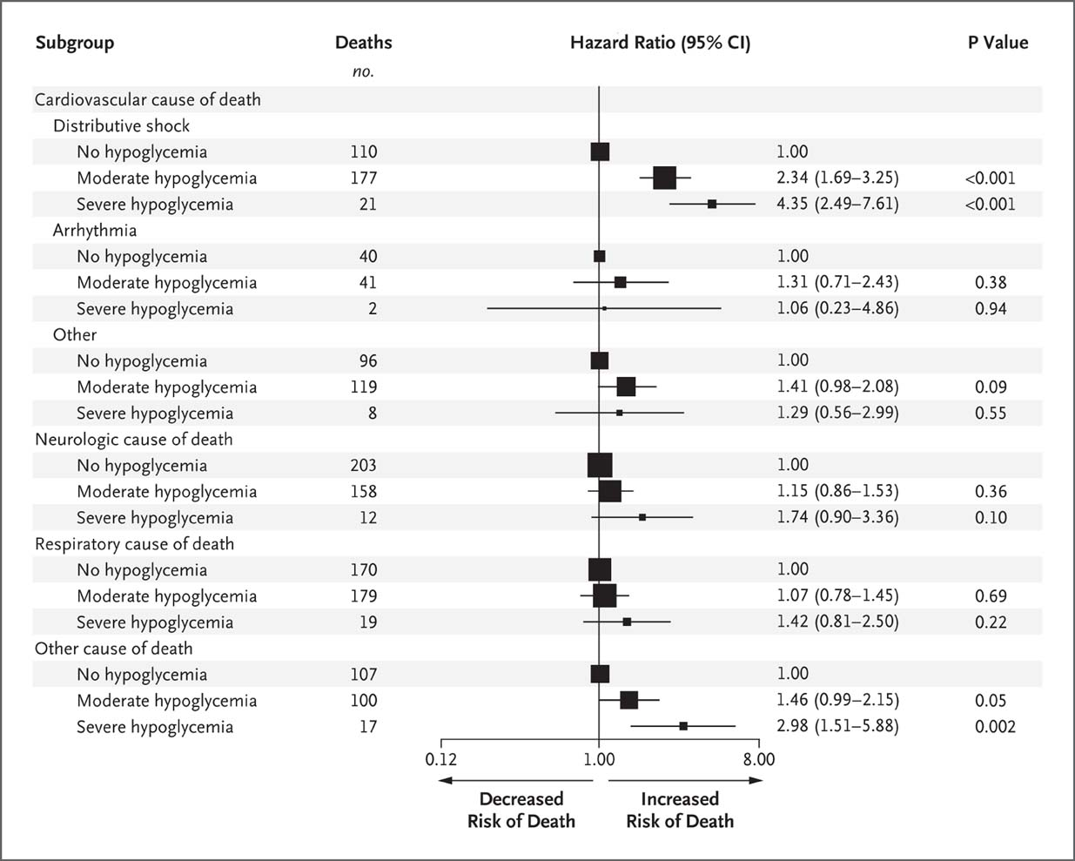
Hazard Ratio for Death from Specific Causes According to the Occurrence of Moderate or Severe Hypoglycemia.
The NICE-SUGAR Study Investigators. N Engl J Med 2012;367:1108-1118
Notes:
Figure 4 Hazard Ratio for Death from Specific Causes According to the Occurrence of Moderate or Severe Hypoglycemia. The hazard ratio for death from distributive (vasodilated) shock was significantly higher for patients with moderate or severe hypoglycemia than for those who did not have hypoglycemia. Patients with severe hypoglycemia also had an increased hazard ratio for death from miscellaneous causes. The size of the squares is proportional to the number of deaths.

Slide 16
Study Conclusions
In this study, critically ill patients in the intensive care unit were randomly assigned to undergo intensive or conventional glucose control.
Intensive control led to moderate hypoglycemia and severe hypoglycemia, which were associated with an increased risk of death.
The association exhibits a dose–response relationship and is strongest for death from distributive shock.

Slide 17
Original Article Early versus Late Parenteral Nutrition in Critically Ill Adults
Michael P. Casaer, M.D., N Engl J Med
Volume 365(6):506-517 - August 11, 2011

Slide 18
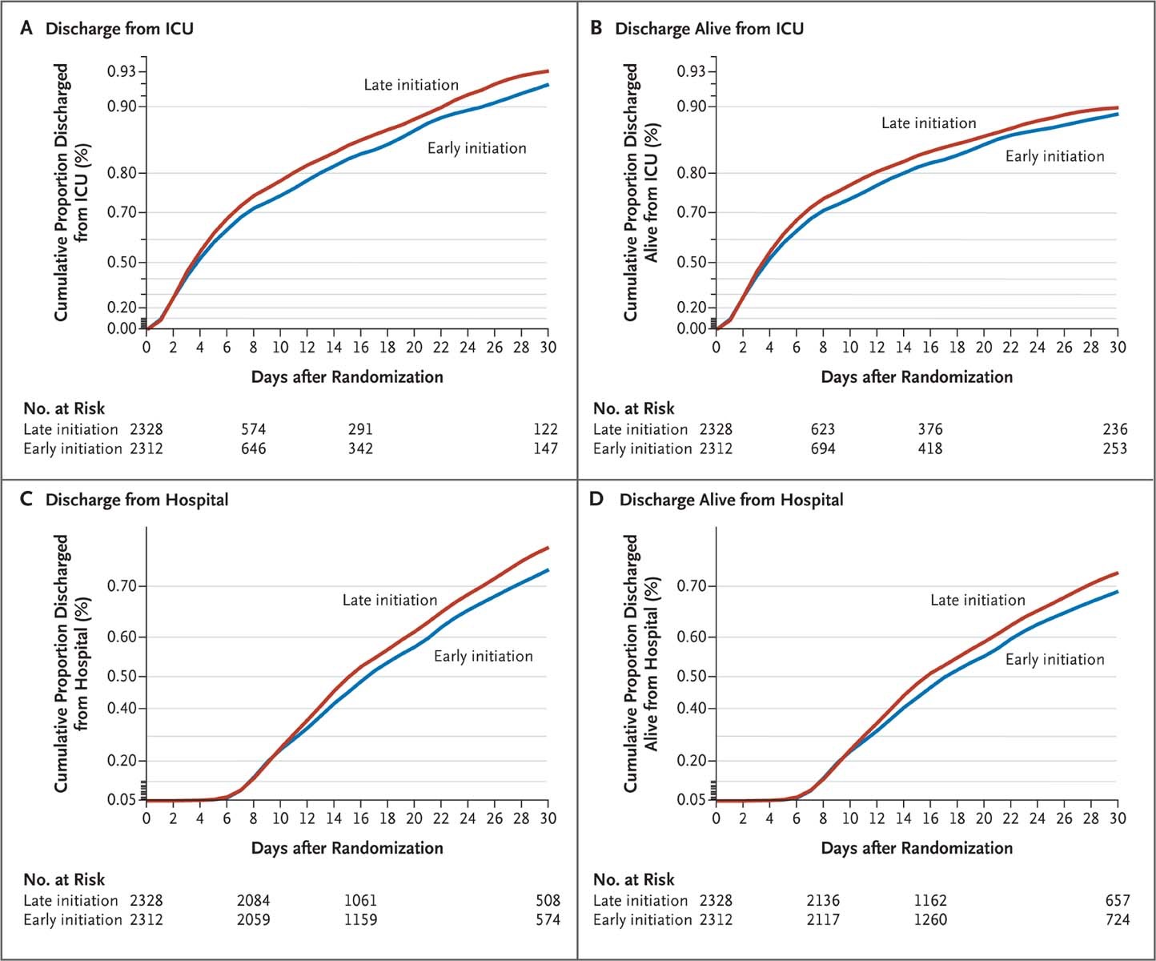
Kaplan–Meier Estimates of the Time to Discharge from the Intensive Care Unit (ICU) and from the Hospital.
Casaer MP et al. N Engl J Med 2011;365:506-517
Notes:
Figure 3 Kaplan–Meier Estimates of the Time to Discharge from the Intensive Care Unit (ICU) and from the Hospital. Shown are the cumulative proportions of patients who were discharged from the ICU (Panel A), discharged alive from the ICU (Panel B), discharged from the hospital (Panel C), and discharged alive from the hospital (Panel D). For the analysis of the time to discharge from the ICU and the hospital, data for patients who died were censored at the time of death. For the analysis of the time to discharge alive from the ICU and the hospital, data for patients who died were censored at a time point after the last surviving patient had been discharged.35 Plots were drawn for the first 30 days after randomization, for the sake of clarity. The effect size was calculated by Cox proportional-hazards analysis for the entire stay in the ICU and the hospital, except for one patient who was still in the hospital 90 days after the enrollment of the last patient, whose data were censored at 90 days.

Slide 19
Study CONCLUSIONS
This controlled, randomized, multicenter trial compared early initiation (<2 days) with late initiation (≥8 days) of parenteral nutrition in adults in the intensive care unit.
Late initiation of parenteral nutrition was associated with faster recovery and fewer complications, as compared with early initiation.

Slide 20
Review Article: Critical Care Medicine Nutrition in the Acute Phase of Critical Illness
Michael P. Casaer, M.D., Ph.D., and Greet Van den Berghe, M.D., Ph.D.
N Engl J Med
Volume 370(13):1227-1236
March 27, 2014

Slide 21
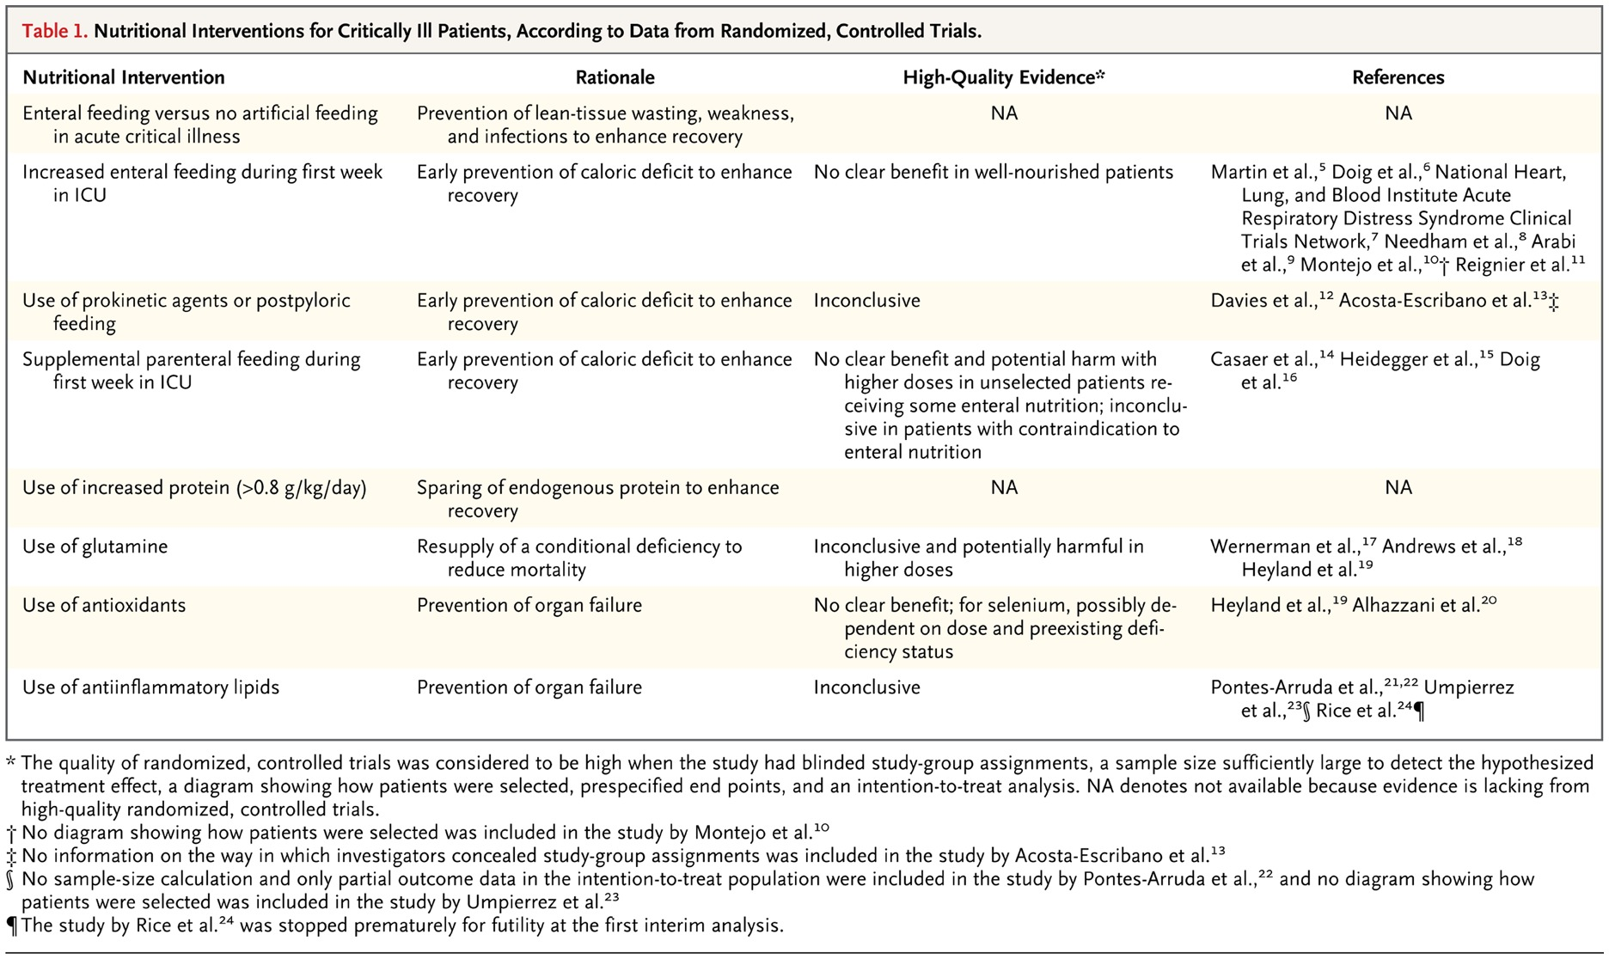
Nutritional Interventions for Critically Ill Patients, According to Data from Randomized, Controlled Trials.
Casaer MP, Van den Berghe G. N Engl J Med 2014;370:1227-1236
Notes:
Table 1 Nutritional Interventions for Critically Ill Patients, According to Data from Randomized, Controlled Trials.

Slide 22
Take Home Message

Slide 23
Take Home Message
Nei pazienti ricoverati in terapia intensiva il target glicemico raccomandabile è compreso fra 140 e 180 mg/dl
Nei pazienti ricoverati in terapia intensiva l’inizio tardivo (dopo 7 giorni) della nutrizione parenterale si correla con minore ospedalizzazione e complicanze

Slide 24
Curiosità

Slide 25
